Slide 1
Designing and building a backup solution with Data Protection Manager

Slide 2

Jan-Tore Pedersen
Senior Consultant @ CTGlobal
Azure Stack HCI/S2D
System Center
Azure/Azure Stack
Windows Server Software
https://jtpedersen.com
Twitter:@jantorep
Organizer and Speaker for SCUG.no

Slide 3
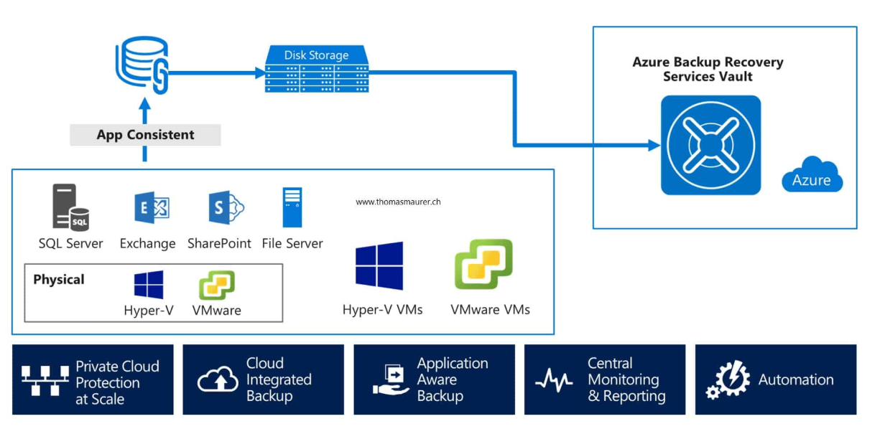
What Workloads are you backing up?
SQL
Exchange
Virtual Machines
File Servers
Others?

Slide 4
Design Considerations
DPM or Azure Backup Server?
Physical/Virtual
Why should I run DPM virtual?
Easy to move to new HW
Deduplication of the Virtual DPM Server’s Storage
Multiple DPM servers to spread load (Soft limit of 120TB pr DPM server)
Notes:
In all deployments you’ll need:
A SQL Server instance, installed and running, to use for the DPM database. The instance can be collocated on the DPM server or remote.
Disk to be used as dedicated space for DPM data storage.
DPM protection agent installed on computers and servers you want to protect using DPM.
https://docs.microsoft.com/en-us/system-center/dpm/prepare-environment-for-dpm?view=sc-dpm-1807
Disk for storage pool 1.5 times the size of the protected data
Recommended: 2-3 times the size of the protected data
Modern Backup Storage Use Volumes.
A single DPM server has a soft limit of 120 TB storage.

Slide 5
Design Considerations
Disk Setup
Recommended to use Tierd Storage with Storage Spaces for MBS
SSD/NVME for fast capacity layer for hot write and reads. And HDD for extending storage.
Recommended to have a set SSD/NVME % based on your daily backup change
If you backup 2TB each day, set SSD/NVME tier to min 4TB or 10% of HDD Capacity
Using SSD/NVME in cache only allows Write Cache and no extra capacity
Provision SSD and HDD VHDX files for the Virtual Machine

Slide 6
Demo
Hyper-V Storage

Slide 7
Deduplication DPM Storage
DPM Running as a virtual Machine on a Hyper-V Host/Cluster
DPM Storage using VHD/VHDX files stored on local storage, SMB3 fileshares or on CSV’s
ReFS recommended for Virtual Machine storage.
Up to 90% storage Savings with Deduplication

Slide 8
Demo
Dedupe Saving

Slide 9
Design Considerations
Network
Dedicated Backup network
Update Hosts files on Hyper-V Servers and DPM server
Use Add-BackupNetworkAddress to set preferred Backup Network

Slide 10
DPM retentions
Short Term Backup to local disk
Up to 64 recovery points
Long Term Backup
To tape or Azure. Allows for up to 99 years of retention
Protection Groups
Design them to run outside of business hours
Do not overlap Protection Groups
Create multiple to not do too much at a single point
Give time for a protection group to run abit longer

Slide 11
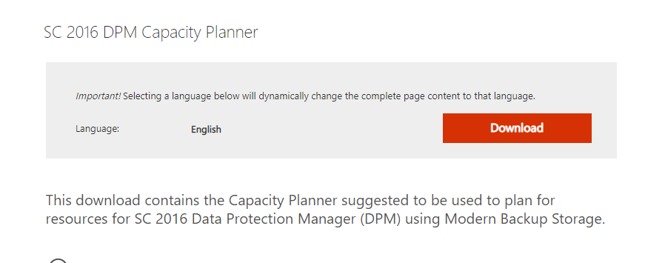
DPM Capacity Planner
https://www.microsoft.com/en-us/download/details.aspx?id=54301

Slide 12
SQL Server Installation Recomendations
SQL_Latin1_General_CP1_CI_AS
Leave 4-6GB of ram to the OS
Use dedicated Service Account for DPM server

Slide 13
Antivirus Exclusions
Exclude folders inside DPM structure
\XSD
\Temp\MTA
\Bin
Exclude Processes
CSC.EXE
DPMRA.EXE
For DPM with Mars Agent exclude following folders
\Microsoft Azure Recovery Agent\Bin
\Scratch
The following Process needs to be excluded from real-time scanning
CBENGINE.EXE
CSC.EXE

Slide 14
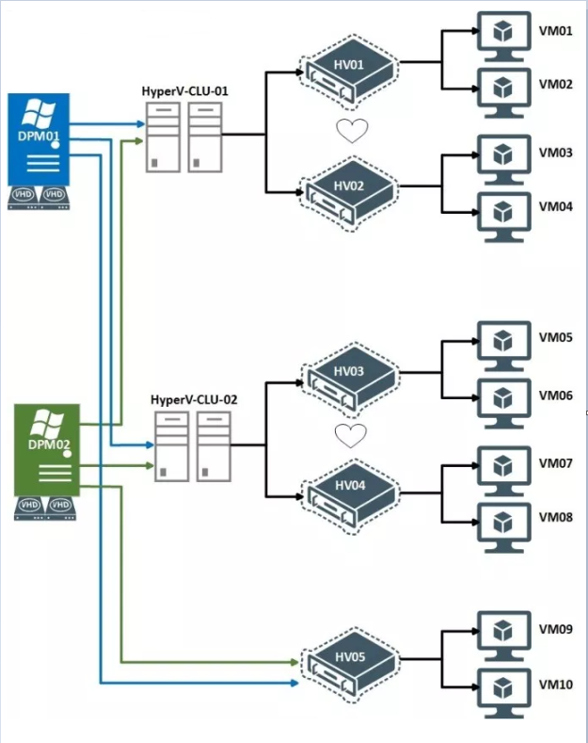
Protecting Large Hyper-V Clusters
Scale Out Protection
To add a 2nd DPM server to same host use
SetDPMServer –Add –DPMServerName DPMSERVER-FQDN

Slide 15
Demo

Slide 16
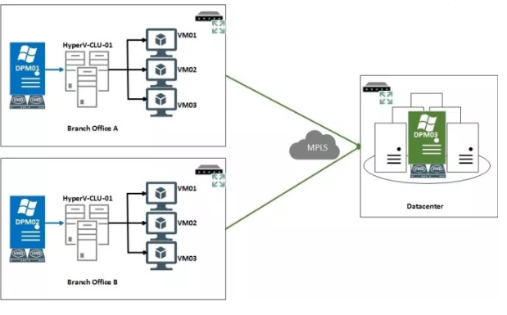
Secondary or Offsite Protection
2nd or 3rd DPM Server Offsite or Local
Azure Recovery Services Vault

Slide 17
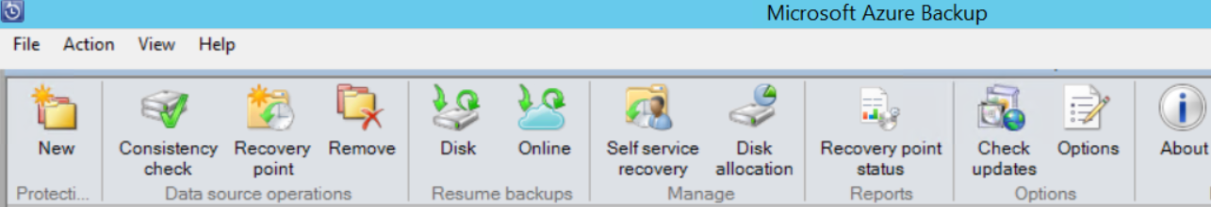
Azure Backup Server
DPM without tape support
No System Center License
Free for Azure Backup Users
Need Azure Recovery Services Vault
https://docs.microsoft.com/en-us/azure/backup/backup-azure-microsoft-azure-backup

Slide 18
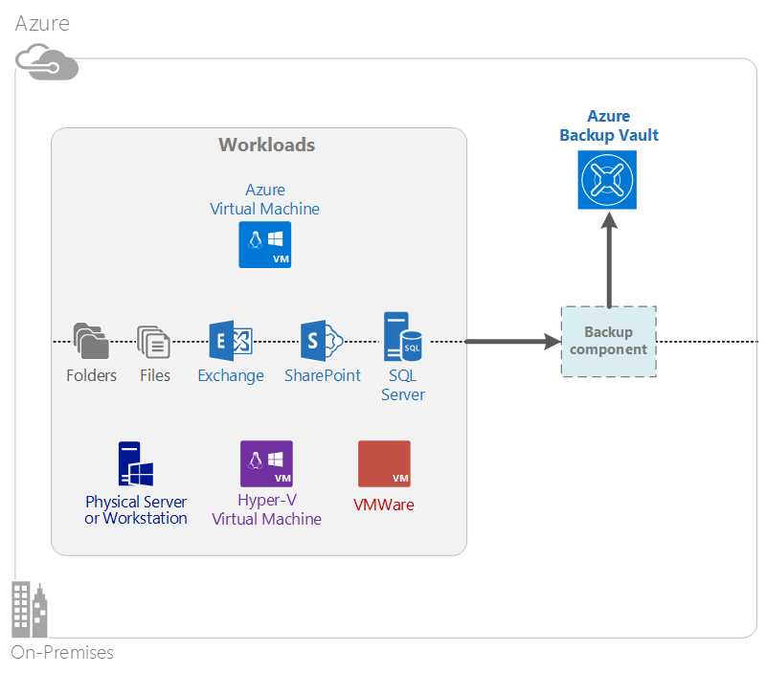
Azure Backup
Unlimited Scaling
Unlimited data transfer
Data Encryption
Long Term retention
Mars Agent Installation on each node
Standard Azure Storage Consumption

Slide 19
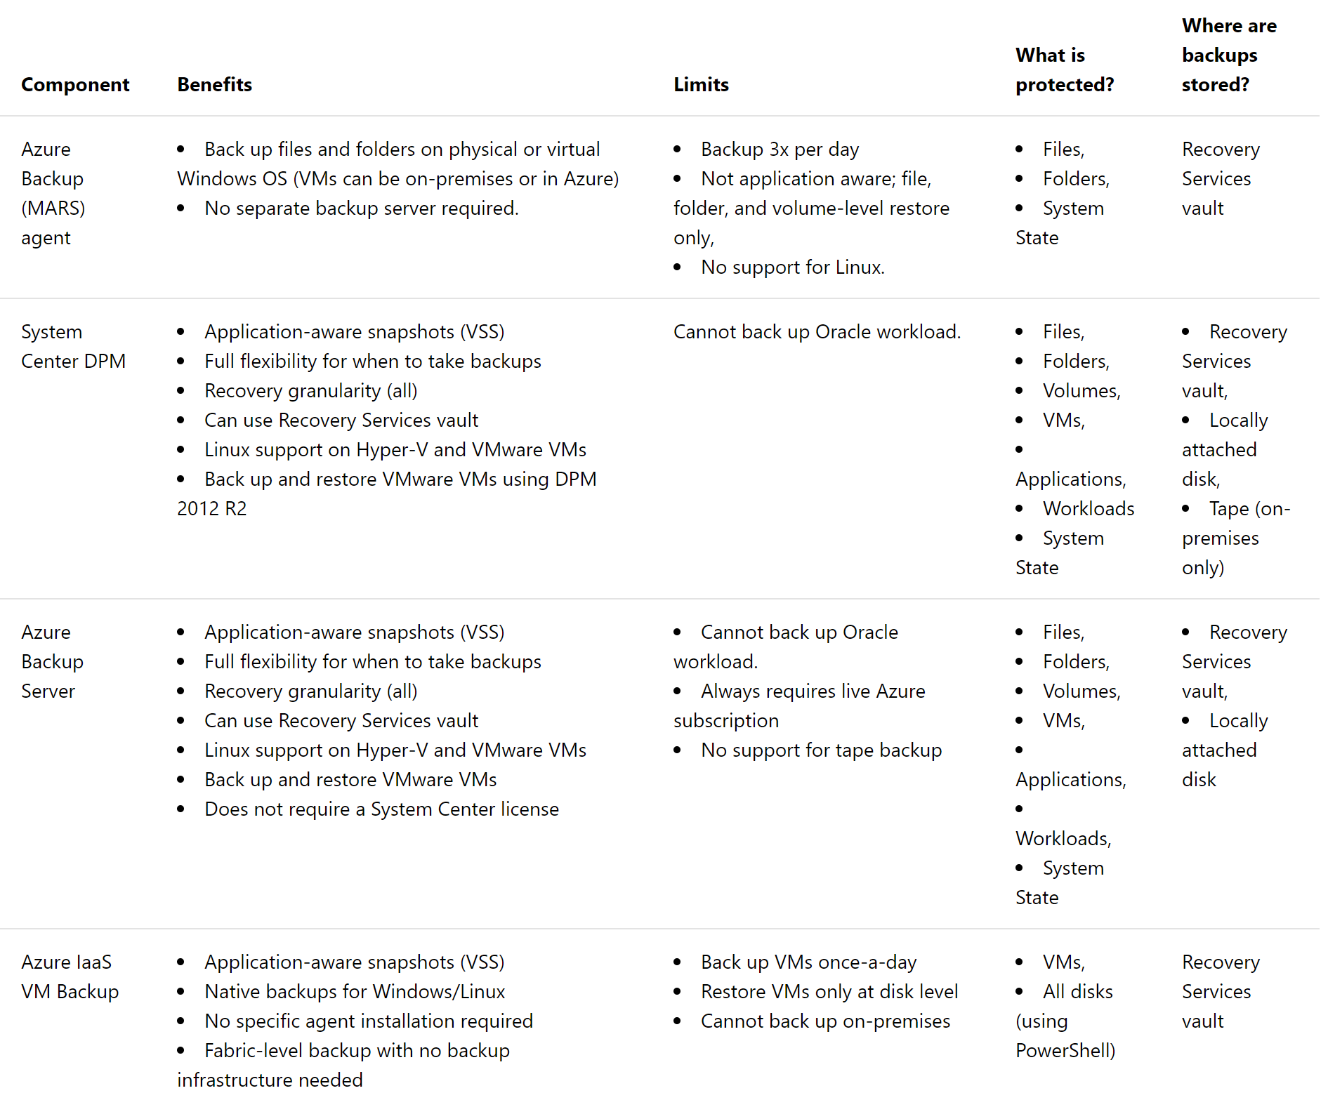

Slide 20
Tools to estimate cost in Azure
PowerShell Script
https://gallery.technet.microsoft.com/Estimating-Azure-Backup-e0d4abbc
The script collects information from the DPM database on the datasource sizes, machines, and recovery points. This information is processed, aggregated, and presented as an HTML output file.
Use the TCO calculator excel sheet
https://gallery.technet.microsoft.com/Azure-Backup-Monthly-bill-093fd095
An excel sheet to simplify the work of estimating the actual Azure bill.

Slide 21
Now what, recovery does it work?
Most important thing TEST BACKUP regularly
Restore a VM
Restore a file from file backup
Restore a SQL Database
Restore Exchange

Slide 22
Demo
DPM Restore

Slide 23
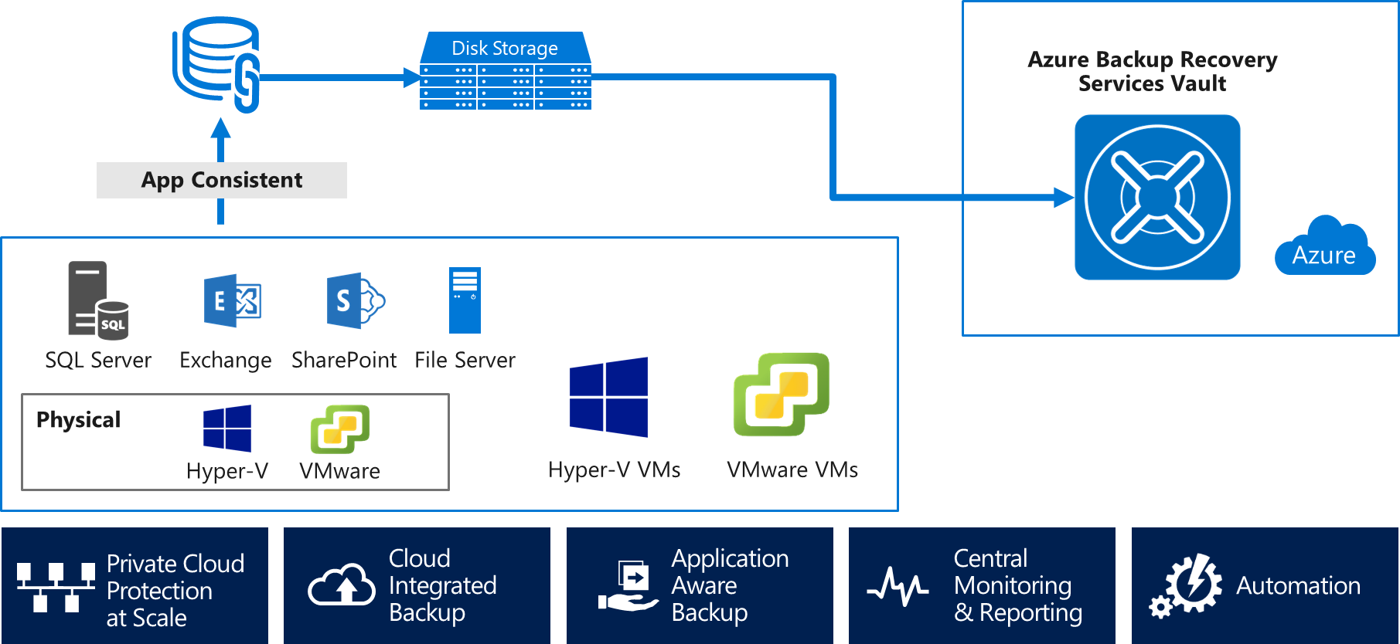



DPM 2019
Support Windows Server 2019, SQL Server 2017
VMware to tape backup
Modern backup storage improvements
Greater flexibility in recovering from Azure

Slide 24


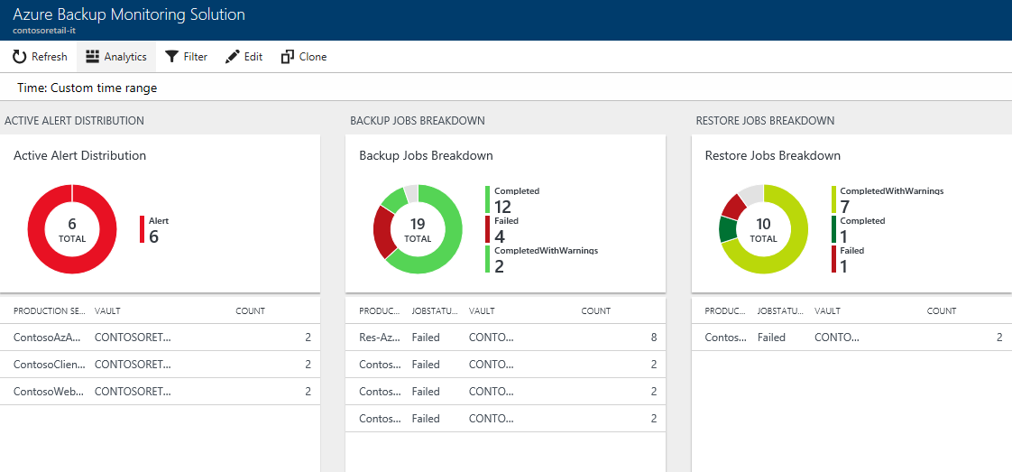
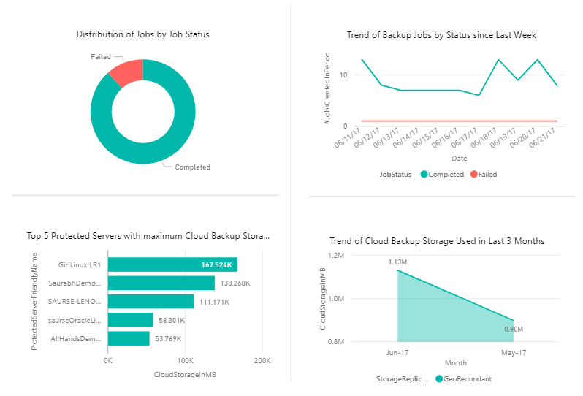
Rich Reporting and Monitoring
Log Analytics
Custom Queries
ITSM Integration
Azure Backup
No infrastructure
System Center DPM
Enterprise Wide
Power BI
Custom Reports
Azure Storage
Microsoft
Azure Backup Server
Cross tenant support

Slide 25
Demo
Azure Backup Integrations

Slide 26
Thanks for joining
Blog: https://jtpedersen
Twitter: @jantorep
https://storagespacesdirec.slack.com

Slide 27











Danke an unsere Partner!
Platinum Sponsor
Gold Sponsoren

Slide 28







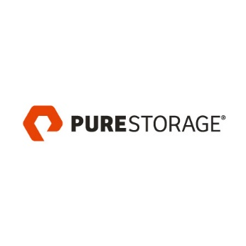


Danke an unsere Partner!
Gold Sponsoren
Silber Sponsoren

